Slide 1


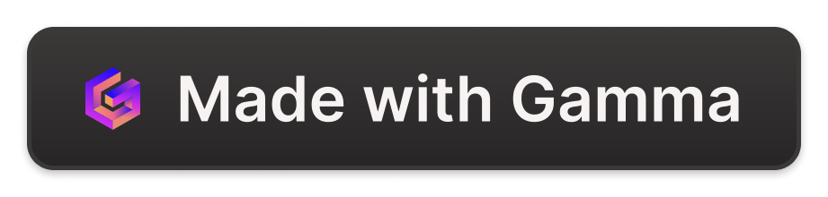
MarketWise
Zero-One
Atharva Shetty
Aditya Agarwal

Slide 2
Recommendation System
Content Based
Collaborative based
Popularity based
Our recommendation engine analyzes user preferences and behaviors to provide tailored product and content suggestions, enhancing the customer experience.
By surfacing relevant items, the system drives increased engagement and conversion rates, benefiting both the user and the business.
We've designed a robust, scalable recommendation system that can handle large volumes of data and deliver real-time suggestions.

Slide 3
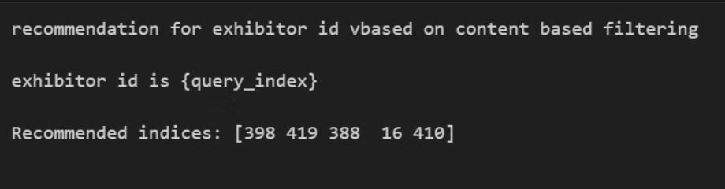
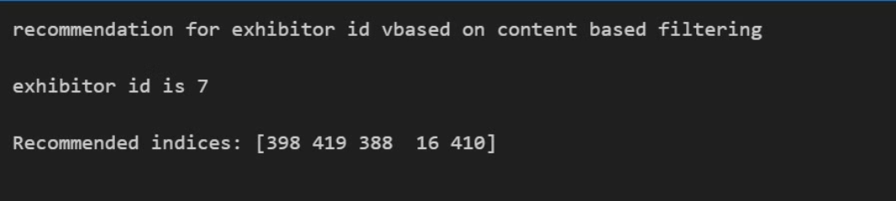
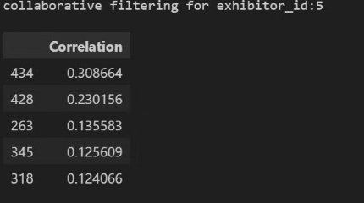

Slide 4
Real-Time Visitor and Exhibitor Interaction
Visitor Tracking
1
Utilizing Wifi, Location and bluetooth to calculate close proximity of visitor and exhibitor.
2
Contextual Engagement
These counts and interaction time are feeded to the recommender system to calculate popularity filtering
Face Detection
3
Indulging face recognition to enable the visitors to get information on the exhibitors through registered database

Slide 5

Time Series Forecast for Exhibition Attendance
1
Predictive Analytics
2
Resource Planning
Our time series forecasting model leverages historical data and relevant factors to accurately predict future exhibition attendance.
With reliable attendance forecasts, organizers can optimize resource allocation, staffing, and logistics for a successful event.
3
More Features
Incorporating weather and time series of the attendees to make a robust model for perdiction

Slide 6
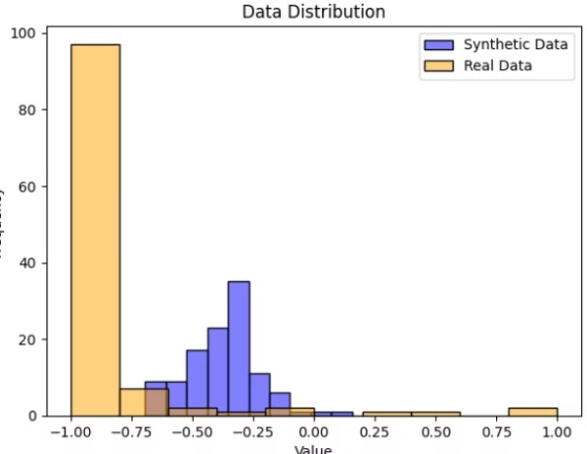
Utilizing GANs for Continuous Time Series Data Generation
In our project, we tackle the challenge of non-continuous time series data by employing Generative Adversarial Networks (GANs) to generate synthetic numerical values. This approach ensures data continuity without resorting to random assumptions, enhancing the accuracy of our forecasting models.

Slide 7
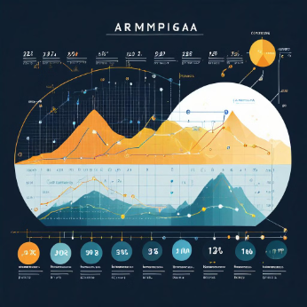
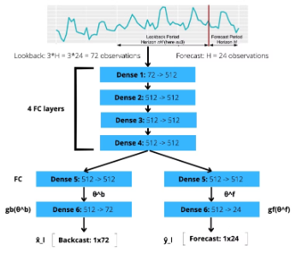
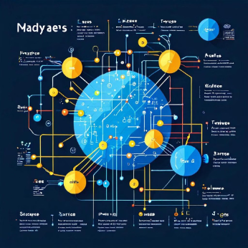
Model used for Timeseries Forecast
ARIMA
NBEATS
Naive Bayes
ARIMA is a time travel wizard for data, predicting the future by analyzing past trends, changes over time, and random fluctuations."
A cutting-edge neural network for time series forecasting, adept at unraveling intricate patterns and providing precise predictions
A simple yet effective probabilistic classifier, widely used for tasks like text classification and spam filtering due to its ease of implementation and good performance

Slide 8
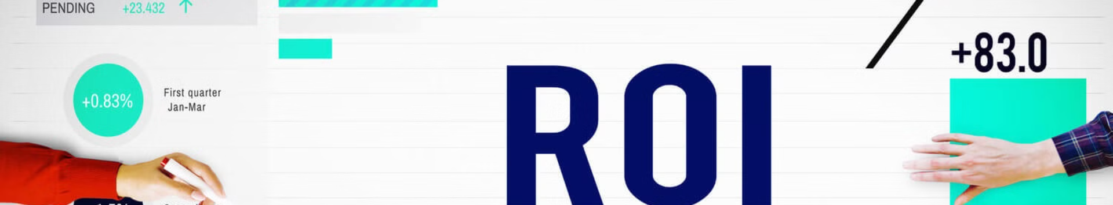
ROI on Investment using ML
Predictive Modeling
Intensive Data Engineering
Ensembling Best models
We apply advanced machine learning techniques to forecast the expected return on investment for various marketing and operational initiatives.
We extracted meaningful insight from unorganized real world data which also included high level data preprocessing
Integrated best performing models to make an even better model predicting ROI for the investor

Slide 9
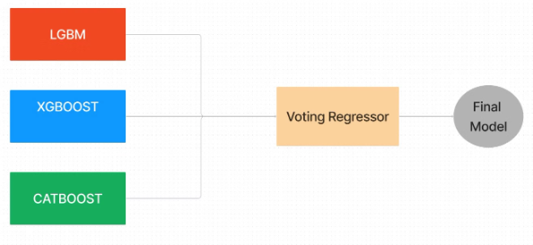
Model Architecture
Three models were tuned with best parameters and then ensembled using Voting Regressor to predict the final result

Slide 10

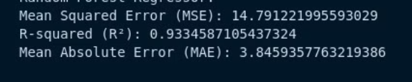
Noteworthy Features
LLM and SerpAPI
Metrics
Utilizing the power of LLM along with SerpAPI to make the unorganized data, organized and for feature Engineering
For our 10% testing we got the above results using an ensembled model

Slide 11




Our Unique Idea
Custom Generative AI
We trained a custom GAN to evaluate and missing data rather than using toy or random values.
Synergy with LLM and Serp
Generated unique features by using SerpAPI and leveraging LLM to get real data about a company.
User Item Matrix
Made user item Matrix for collaborative filtering using our visitor and exhibitor dataset.

Slide 12




Our Robust Models
Recommendation System
NMF( Non matrix factorization)
User Satisfacation
Wifi, bluetooth, location and Face recognition.
Time Series
ARIMA, NBeats, Naive Bayes, Ensembling
ROI
Catboost, Xgboost , Lightbgm

Slide 13
Conclusion
Our team, Zero-One, is proud to present our comprehensive suite of solutions that address the diverse challenges faced by exhibition organizers. Through our innovative approach and deep technical expertise, we aim to redefine the event experience and drive lasting impact for our clients.
THANK YOU

